Slide 1

IMAGE
CAPTIONING
Department of Computer Science & Engineering
Project ID: PCSE23-17

Slide 2
GROUP MEMBERS:-
● SAGAR SRIVASTAVA
● TUSHAR PANT
● ANSHIKA
PROJECT GUIDE:-
● Prof. UPENDRA MISHRA

Slide 3
INTRODUCTION
Image captioning involves generating a textual description of an image using computer vision and natural language processing methods. This process requires both object recognition and detection, as well as an understanding of the scene and the relationship between different elements in the image. There are two primary categories of techniques used for image captioning: conventional machine learning and deep machine learning approaches. While conventional machine learning relies on manually created features, deep machine learning approaches such as Convolutional Neural Networks (CNNs) can automatically discover features from training data.

Slide 4
OBJECTIVE
The main objective of an image captioning project is to develop a system that can generate natural language descriptions of images. This involves utilizing computer vision techniques to analyze the visual content of the image, as well as natural language processing techniques to generate human-readable descriptions.
The goal is to create a system that can assist individuals with visual impairments, enhance search engine optimization, facilitate e-commerce, suggest content ideas, and aid in the creation of educational materials for students.

Slide 5
TECHNOLOGY
Image captioning is a complex task that involves the use of several technologies. Here are some of the key technologies used in image captioning projects:
Convolutional Neural Networks (CNNs): CNNs are a type of deep learning neural network that are commonly used in image recognition tasks. They are used to extract features from images and identify important visual elements in the image.
Recurrent Neural Networks (RNNs): RNNs are another type of deep learning neural network that are commonly used in language modeling tasks. They are used to generate a sequence of words that describe the image.

Slide 6
TECHNOLOGY
Natural Language Processing (NLP): NLP is a subfield of artificial intelligence that focuses on the interactions between computers and human language. It is used to analyze and generate natural language text, which is essential for generating image captions.
Encoder-Decoder Architecture: This architecture is commonly used in image captioning projects. It involves using a CNN to encode an image and a language model (such as an RNN) to generate a sequence of words that describe the image.
Attention Mechanism: Attention is a mechanism that helps the language model focus on specific parts of the image when generating captions. It allows the model to attend to the most relevant visual features when generating the corresponding words.

Slide 7
APPLICATIONS
The image captioning project has numerous practical applications across different industries, some of which are:
Accessibility: Image captions can aid individuals with visual impairments by providing textual descriptions of images that they may not be able to see.
Search engine optimization (SEO): Providing captions for every image on the internet can potentially result in faster and more accurate image searches and indexing, leading to better SEO.
E-commerce: Image captions can provide detailed product information, which can enhance the user's understanding of the product, leading to higher sales.

Slide 8
APPLICATIONS
Biomedicine: Image captioning can assist in the analysis of medical images and help identify abnormalities, assisting medical professionals in the diagnosis and treatment of illnesses.
Military operations: Image captioning can assist in military operations by identifying objects in aerial imagery, detecting potential threats, and providing situational awareness.
Social media: Social media platforms such as Instagram and Facebook can automatically generate captions from images, improving the user experience and accessibility for their users.

Slide 9
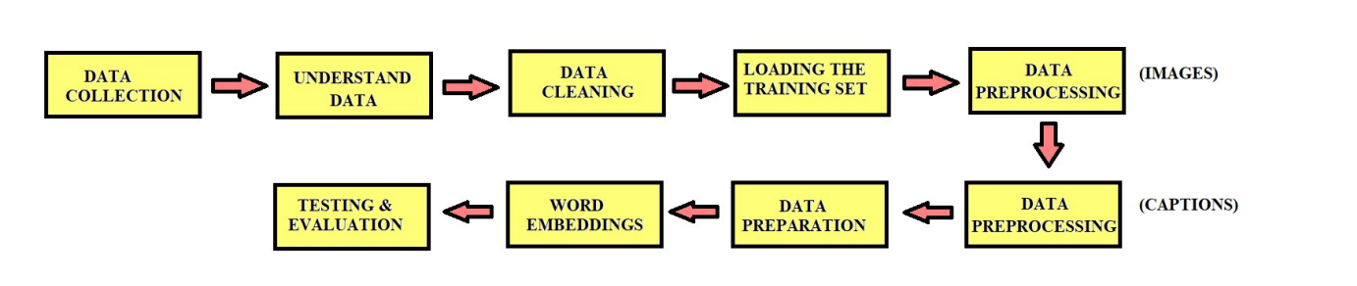
IMPLEMENTATION
Data Collection: The case study uses the Flickr 8k dataset which contains 8000 images, each with 5 captions. This dataset is divided into a training set of 6000 images, a dev set of 1000 images, and a test set of 1000 images.
Understanding Data: The Flickr8k dataset comes with text files that contain the name of each image and its five captions. To create a dictionary that associates each image with its captions, we can read the "Flickr8k.token.txt" file and use the image names as keys and the list of captions as values.

Slide 10
IMPLEMENTATION
Data Cleaning: When we deal with text, we generally perform some basic cleaning like lower-casing all the words (otherwise“hello” and “Hello” will be regarded as two separate words), removing special tokens (like ‘%’, ‘$’, ‘#’, etc.), eliminating words which contain numbers (like ‘hey199’, etc.).
Loading the training set: The file "Flickr_8k.trainImages.txt" contains image names for the training set. The names are loaded into a list called "train". Descriptions of the images are loaded from "descriptions.txt" and added to the "train_descriptions" dictionary. Two tokens are added to each caption: "startseq" at the beginning and "endseq" at the end.

Slide 11
IMPLEMENTATION
Data Preprocessing: Data preprocessing is the process of transforming raw data into a format that is more suitable for analysis and machine learning models. This involves cleaning, normalization, transformation, and feature extraction. The goal is to improve the quality and accuracy of the data and remove any biases or inconsistencies that may affect the performance of the models. Data preprocessing is a critical step in any data science or machine learning project, as it directly impacts the quality and reliability of the final results.
Data Preparation: Data preparation involves the process of cleaning, transforming, and organizing raw data in a way that makes it suitable for analysis or machine learning. This typically includes tasks such as data cleaning, feature selection or extraction, data normalization or scaling, and splitting the data into training and testing sets. The goal of data preparation is to create a high-quality dataset that can be used for accurate analysis or modeling.

Slide 12
IMPLEMENTATION
Word Embeddings: Word embeddings are a way to represent words as numerical vectors in a high-dimensional space. This helps capture the meaning and context of words in a more meaningful way than traditional one-hot encoding. Word embeddings are often used in natural language processing tasks such as text classification, language translation, and sentiment analysis.

Slide 13
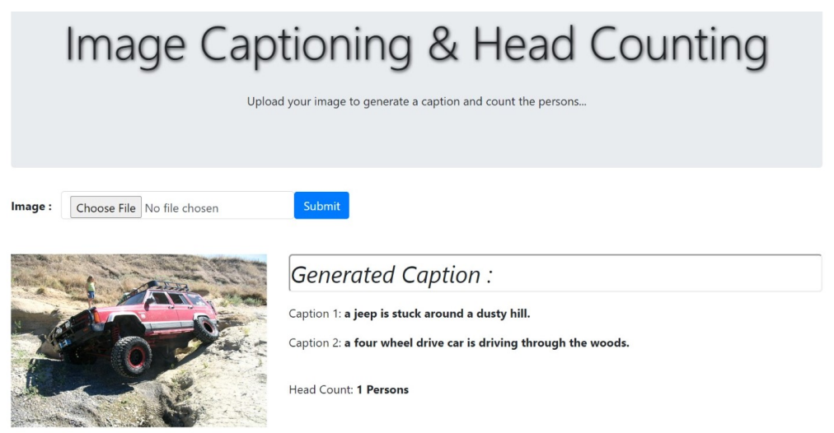
CONCLUSION

Slide 14
THANK YOU

